Slide 1
Individual Homework - Logic Circuits
Crudu Iulian, group 912

Slide 2
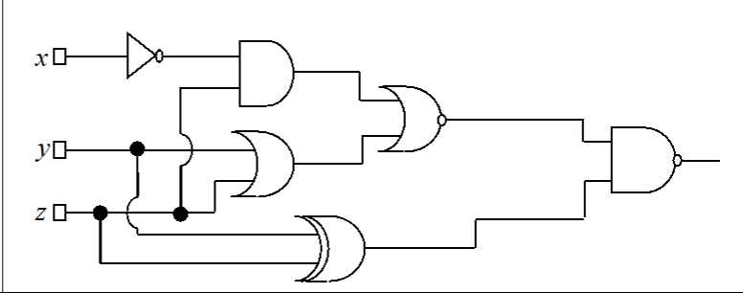
Problem Statement
Write the corresponding Boolean function associated to the following logic circuit, then simplify it and draw a simplified equivalent circuit using only basic gates:

Slide 3
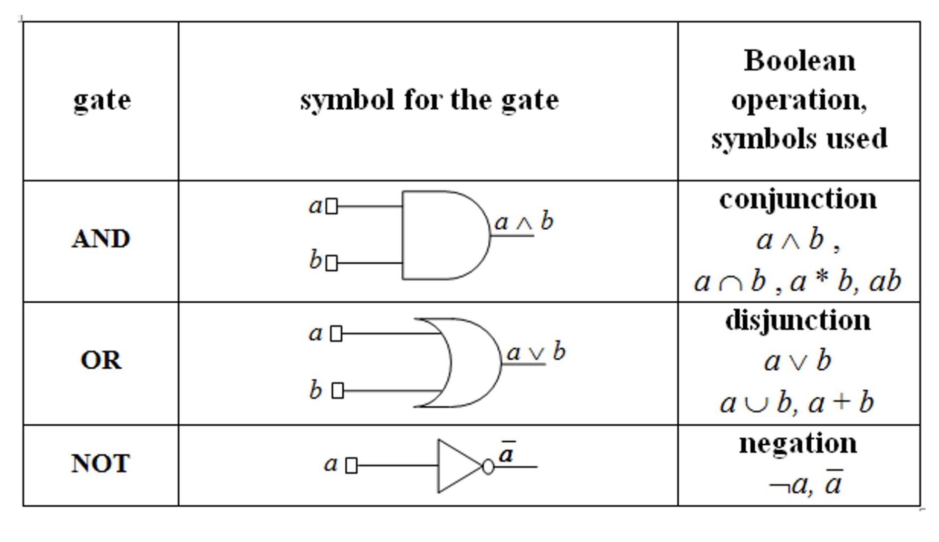
Theory - 1
Binary Boolean algebra provides a concise way to express the operation of a logic circuit formed by a combination of logic gates so that the output can be determined for various combinations of input values.
A gate takes the values from its input wires and combines them with the appropriate Boolean operation to produce the label on its output wire

Slide 4
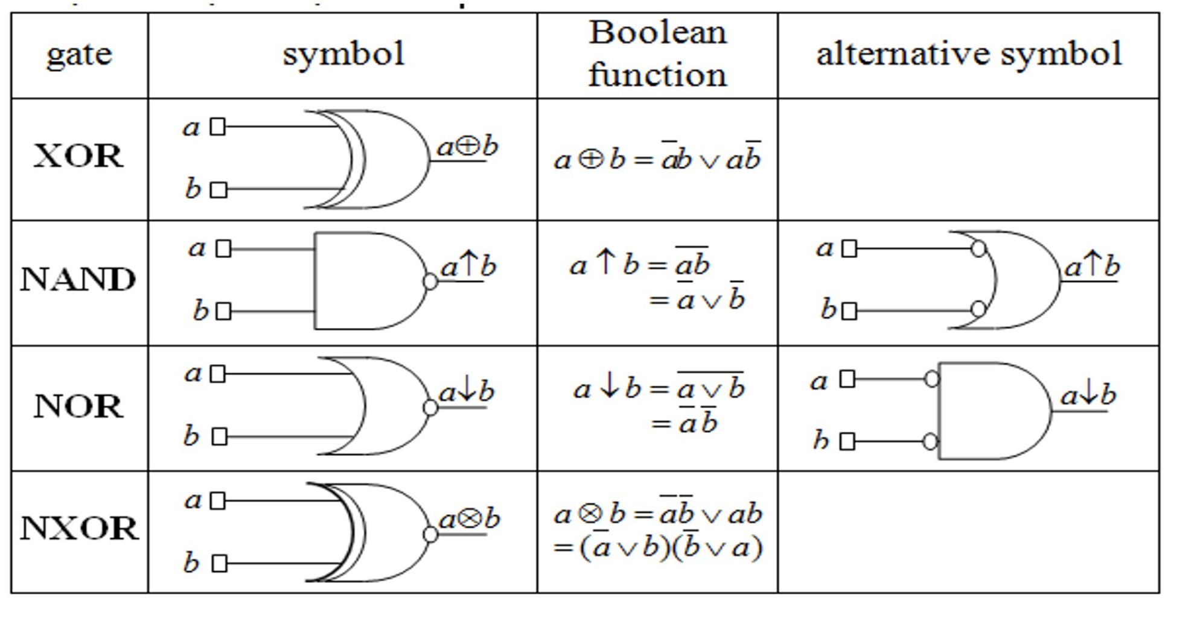
Derived Gates

Slide 5
The corresponding function associated with the logic circuit
f(x,y,z) = ( (x̄∧z) ↓ (y∨z) ) ↑ (ȳz̄∨yz) = !( (x̄∧z) ↓ (y∨z) ) ∨ !(ȳz̄∨yz) =
= !(!(x̄∧z) ∧ ! (y∨z)) ∨ !(ȳz̄∨yz) = ((x̄∧z) ∨ (y∨z)) ∨ (yz ∧ ȳz̄) = x̄z ∨ y ∨ z ∨ yȳzz̄

Slide 6
Simplification process
The simplification process is formalized by the steps below.
The steps 2, 3, 4 are specific to the applied simplification method.
The initial function f is transformed into DCF( f ).
Factorization process => the set of maximal monoms M(f ).
From the set of maximal monoms the central monoms are selected => C (f )
The case of the simplification algorithm (presented below) is identified and all simplified forms are obtained.

Slide 7
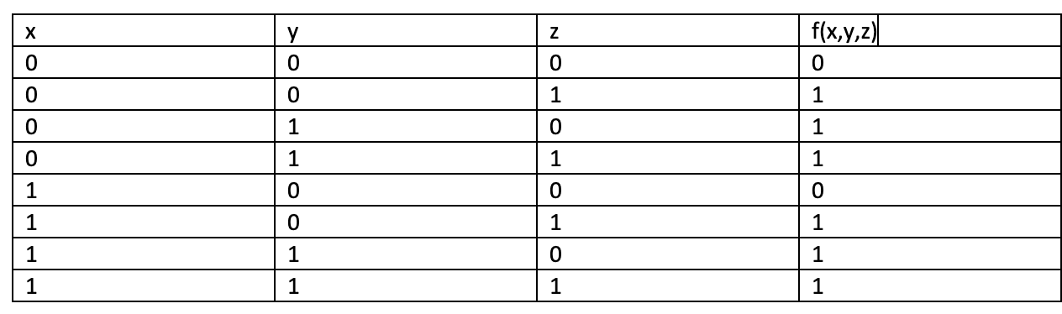
Transforming the function to DCF
The DCF is built by using the minterms corresponding to the values of 1 of the function. To get the values of 1 of the function we will build the truth table.

Slide 8
f(0,0,1) = m1 = x̄ ∧ ȳ ∧ z
f(0,1,0) = m2 = x̄ ∧ y ∧ z̄
f(0,1,1) = m3 = x̄ ∧ y ∧ z
f(1,0,1) = m5 = x ∧ ȳ ∧ z
f(1,1,0) = m6 = x ∧ y ∧ z̄
f(1,1,1) = m7 = x ∧ y ∧ z
DCF(f) = m1 ∨ m2 ∨ m3 ∨ m5 ∨ m6 ∨ m7 = (x̄ ∧ ȳ ∧ z) ∨ (x̄ ∧ y ∧ z̄) ∨ (x̄ ∧ y ∧ z) ∨ (x ∧ ȳ ∧ z) ∨ (x ∧ y ∧ z̄) ∨ (x ∧ y ∧ z)

Slide 9
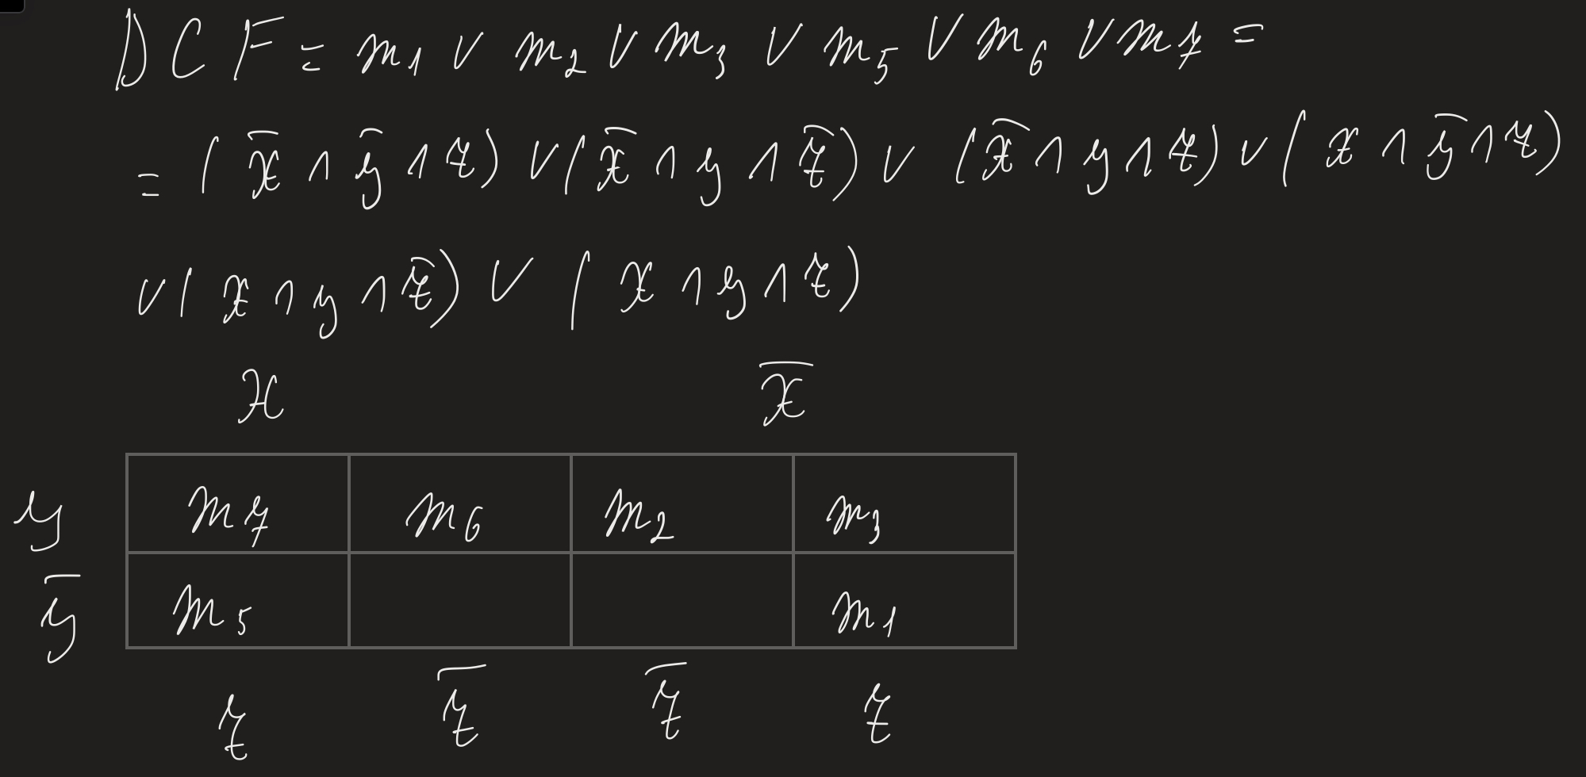
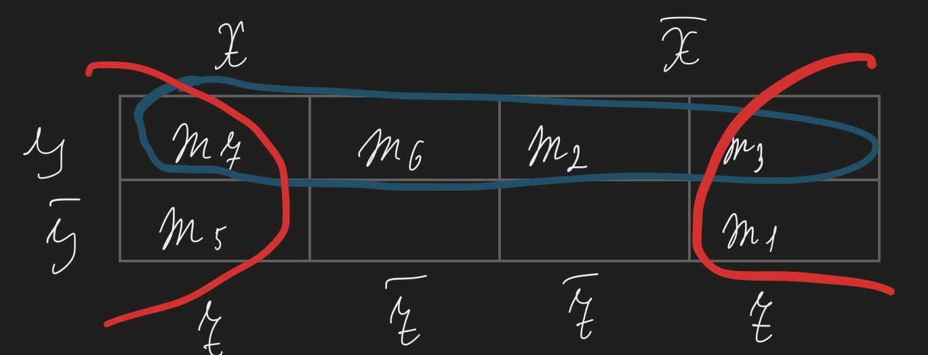
Veitch Diagram and Factorization process
max1 = m2 ∨ m3 ∨ m6 ∨ m7 = (x̄ ∧ y ∧ z̄) ∨ (x̄ ∧ y ∧ z̄) ∨ (x ∧ y ∧ z̄) ∨ (x ∧ y ∧ z) = y
max2 = m1 ∨ m3 ∨ m5 ∨ m7 = (x̄ ∧ ȳ ∧ z) ∨ (x̄ ∧ y ∧ z̄) ∨ (x ∧ ȳ ∧ z) ∨ (x ∧ y ∧ z) = z
M(f) = {max1, max2} = {y,z}

Slide 10
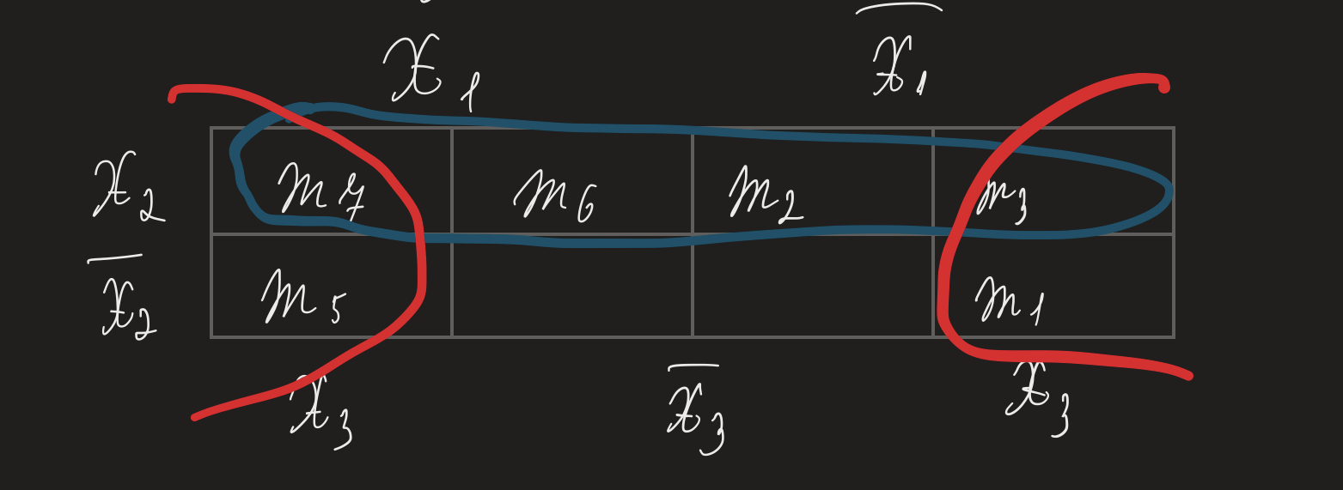
Central Monoms
A maximal monom is a central monom if its corresponding group of minterms contains at least one minterm circled once.
C(f) = {max1, max2} = {y, z}

Slide 11
The case of the simplification algorithm
M(f) = C(f) = {max1, max2} = {y, z}. This means that we are in the first case of the simplification algorithm. There is a unique simplified form of f, obtained as the disjunction of all central monoms:
f(x,y,z) = max1 ∨ max 2 = y ∨ z

Slide 12
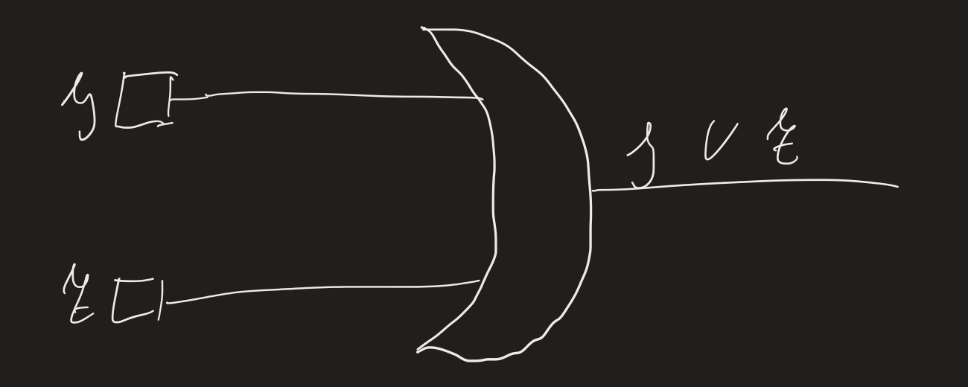
Simplified equivalent circuit with basic gates
f(x, y, z) = y ∨ z

